Slide 1
Decision Memo
for Rep. Matsui
Lauren Lee, Alex Amadeo-Ranch, Daron Kaloustian,
Taly Juarez, Nicholas Meshcheryakov

Slide 2
Summary of BEAD and H.R. 1870
BEAD - Broadband Equity, Access, and Deployment program is a federal initiative administered by the National Telecommunications and Information Administration and represents the largest ever investment in broadband infrastructure in the U.S history
Purpose
To expand high-speed internet access by funding planning, infrastructure deployment, and adoption programs, especially in unserved and underserved communities.
Funding
Allocates $42.45 billion to U.S. states, territories, and D.C.. Funding per state is based on price of implementing broadband technology in the area to unserved and underserved communities.
Priority Areas
Areas with no access to reliable broadband, Underserved areas, High-cost areas where deployment is prohibitively expensive without subsidies.

Slide 3
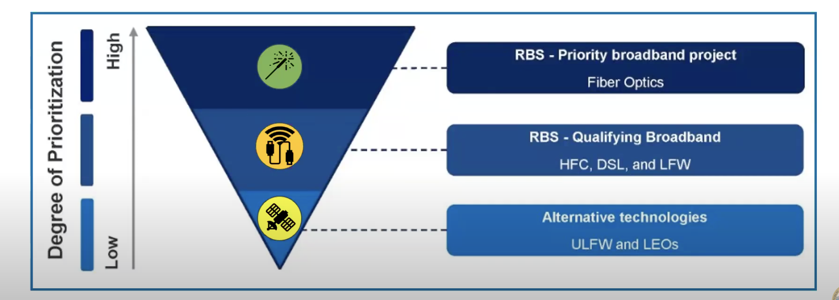
BEAD Broadband Technology Prioritization

Slide 4
H.R. 1870 (aka Speed for BEAD act)
Funding Changes
H.R. 1870 - Speed for BEAD act aims to streamline the program by eliminating certain BEAD requirements.
Utilizes the existing $42.45 billion from the BEAD program but changes how funds can be used and limits reallocation of unused funds.
Eliminates tiering system that currently gives priority to fiber over other technologies.
Bars states from giving priority to companies that can achieve rates and prices set by the states.
Objectives
Speed up deployment by eliminating funding requirements. Remove weighting that is viewed as unfair to certain technologies.
Notes:
-get rids of tiering system
-prevents states from hitting their price targeting points
-currently under bead states are allowed to state rate and price goals to companies, HR 1870 would bar states from being able to do this
-goal of HR, speed up deployment - given money to technologies that could be deployed quicker,

Slide 5
Option 1 - Vote for H.R. 1870
Pros:
Allows for any technology (LEO, unlicensed fixed-wireless, etc) to compete for grants by eliminating the current tiering system
May allow for faster infrastructure deployment
Demonstrates bipartisanship for Representative Matsui, which could label her as solution oriented.

Slide 6

Option 2 - Vote Against H.R. 1870
BEAD currently prioritizes technology that is proven
to be the most high-performance and low latency.
BEAD distributes funding based on the price,
allowing for alternative technologies if applicable
Can prevent government funds being wasted on less reliable tech that may need pricier upgrades in the long term and are potentially less efficient in the short term

Slide 7
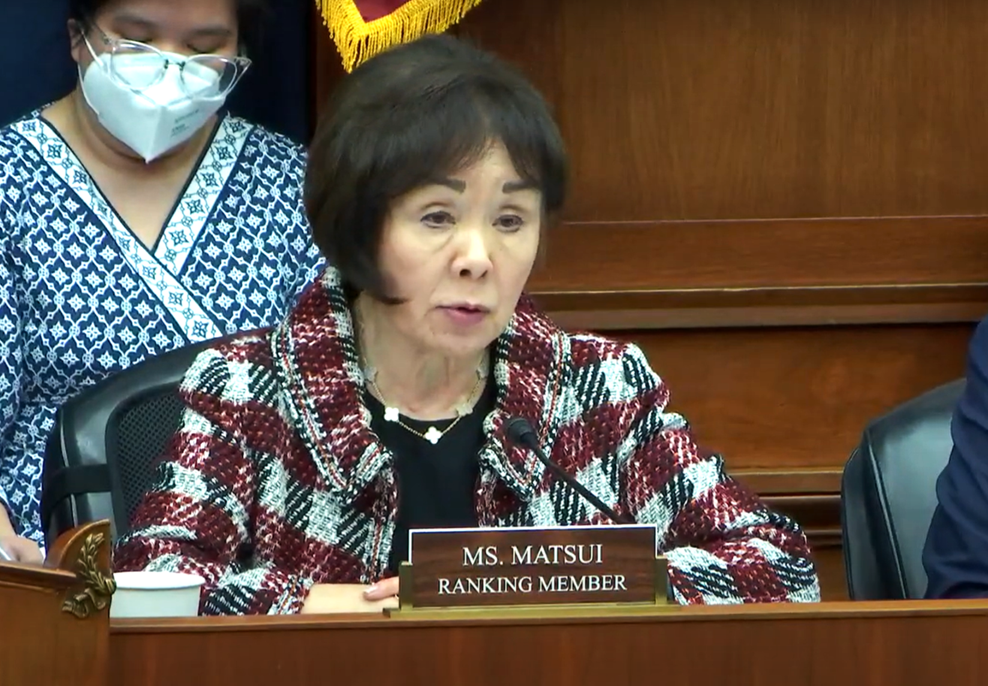
Option 3 - Abstain from Voting
To avoid immediate controversy, don’t take a strong stance or vote in a way that may reflect negative attention.
Voting to change the current infrastructure of digital equity goes against Matsui’s position on BEAD’s guidelines and could affect her credibility on future tech issues.
“Many other states, including California, are hard at work launching a fair and competitive award process and implementing digital equity plans so that our federal broadband dollars go to where they need it the most.” (Rep. Matsui 2025)

Slide 8

Recommendation:
Vote Against H.R. 1870
We recommend that Rep Matsui vote against H.R. 1870.
The current BEAD act ensures that funding prioritizes the best and most reliable technology long-term, while H.R. 1870 will strip away this requirement to allow for more money to be wasted on technology that is less efficient in the long term, harming your constituents.
Due to Rep Matsui’s previous statements about the importance of BEAD and her status as the ranking member on the Communications & Technology subcommittee, it is in both her and her constituents best interest to preserve BEAD.

Slide 9
Bibliography
Eshraghi, A. (2024). California’s BEAD Program Evaluation. https://www.cpuc.ca.gov/-/media/cpuc-website/divisions/communications-division/documents/broadband-implementation-for-california/bead/bead-program-evalutation.pdf
Francis, C. (2025, February 22). Satellite Internet Market Navigating Dynamics Comprehensive Analysis and Forecasts 2025-2033. Marketresearchforecast.com. https://www.marketresearchforecast.com/reports/satellite-internet-market-5124
Hudson, R. (2025, March 6). House Republicans Propose Changes to the BEAD Program. Benton Foundation. https://www.benton.org/blog/house-republicans-propose-changes-bead-program
MATSUI APPLAUDS MILESTONE FOR CALIFORNIA’S BROADBAND EQUITY, ACCESS, AND DEPLOYMENT PROGRAM PROPOSAL. (2024, October 4). Congresswoman Doris Matsui. https://matsui.house.gov/media/press-releases/matsui-applauds-milestone-californias-broadband-equity-access-and-deployment
Satellite Internet Market Size, Share & Industry Analysis, By Frequency Band Type, By End-user, and Regional Forecast. (14 April 2025). https://www.fortunebusinessinsights.com/satellite-internet-market-109242
Stokes, S. A. (2025, March 13). BEAD Reform Raises a Number of Policy Issues and Potentially Adds Delay. Beyond Telecom Law Blog. https://www.beyondtelecomlawblog.com/bead-reform-raises-a-number-of-policy-issues-and-potentially-adds-delay/

