Slide 1
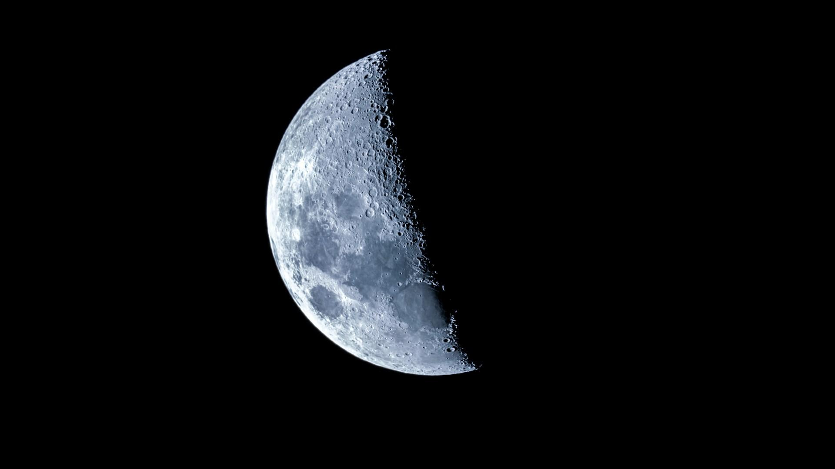
Group B6 Final Project
Shaila Mehta, Gina Liang, Dylan Ly, Alex Amadeo-Ranch, Andy Nguyen, Lelany Perez, Nathan Martinez

Slide 2
Problem Statement
Ice on the Moon is essential for water, oxygen, and fuel production. Lunar craters where ice is mined are exposed to micrometeoroid (small, fast-moving space debris) impacts. Pure ice is brittle and may not withstand high-speed collisions. Waste materials (toilet paper, plastic bags) are commonly available on-site.
Our Task: (1) Test if reinforcing ice with waste materials improves its resistance to impact damage, and (2) estimate the thickness of ice and/or ice composites needed to stop an iron micrometeoroid with density 8 g/cm^3 that is 3 cm in diameter traveling at 42 km/s.

Slide 3
Concepts
Hardness Change
Adding materials like toilet paper or plastic creates a composite material with the ice, which can reduce surface hardness but may also improve resistance to cracking/breaking
Impurities
These waste materials act as impurities, disrupting the natural crystal structure of ice and potentially creating air pockets or uneven freezing, which alters its physical properties
Improved Toughness/Reinforcement
While purity and hardness might decrease, the added materials can increase overall toughness by helping absorb impact energy and prevent sudden brittle failure

Slide 4
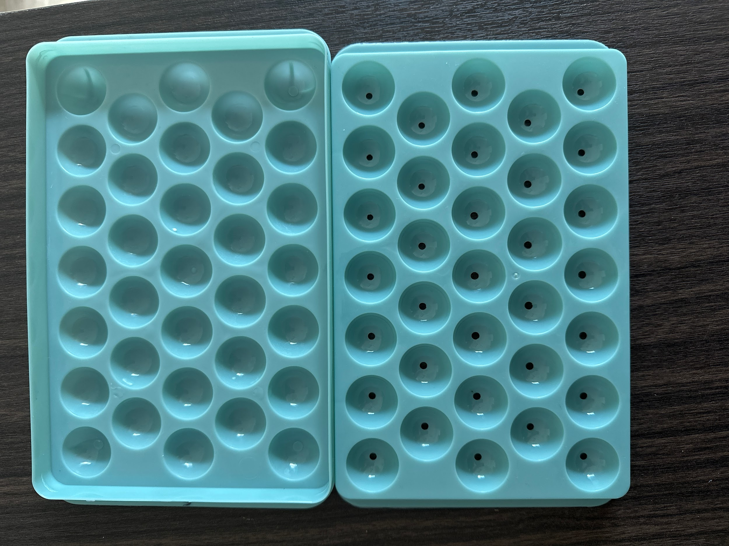
Experiment Plan
Materials Provided:
Ice mold – 33 cavities for 1 inch diameter spheres.
Toilet paper – 5 sheets.
Plastic storage bag – 1 bag.
Plan:
Test different composite types:
  Pure ice (control)
  Ice + toilet paper
  Ice + plastic strips
  Ice + toilet paper + plastic strips
Vary reinforcement amount (weight percent) for each composite
Drop samples from two different heights to simulate different impact energies
Record:
  Drop height
  Estimated damage (%)
  Photo for visual analysis
Ice sample mold
Notes:
Alex

Slide 5
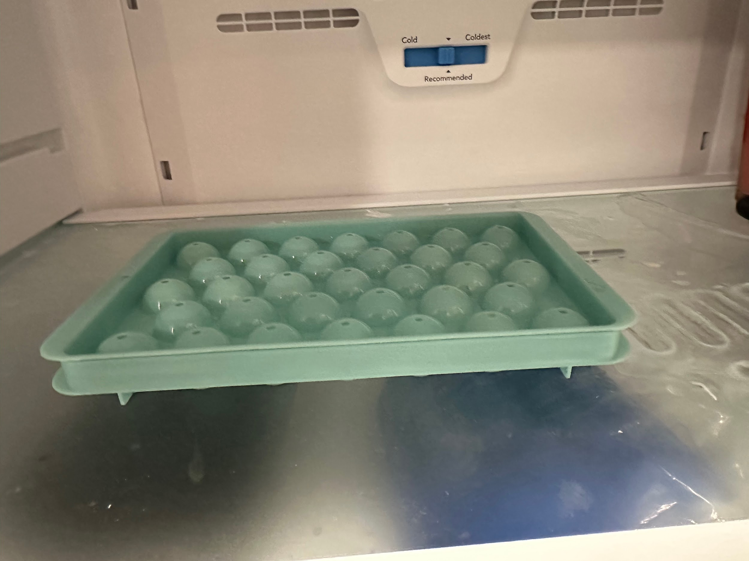
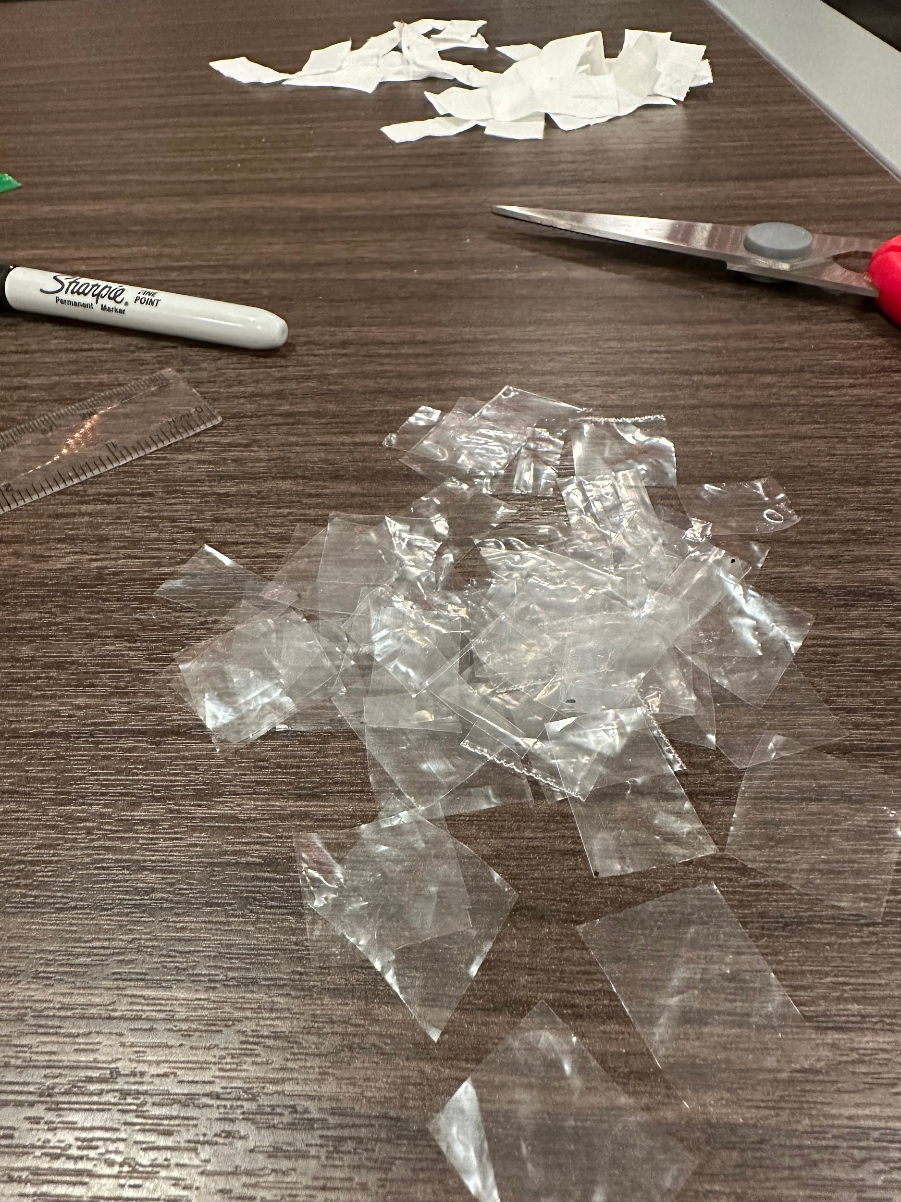
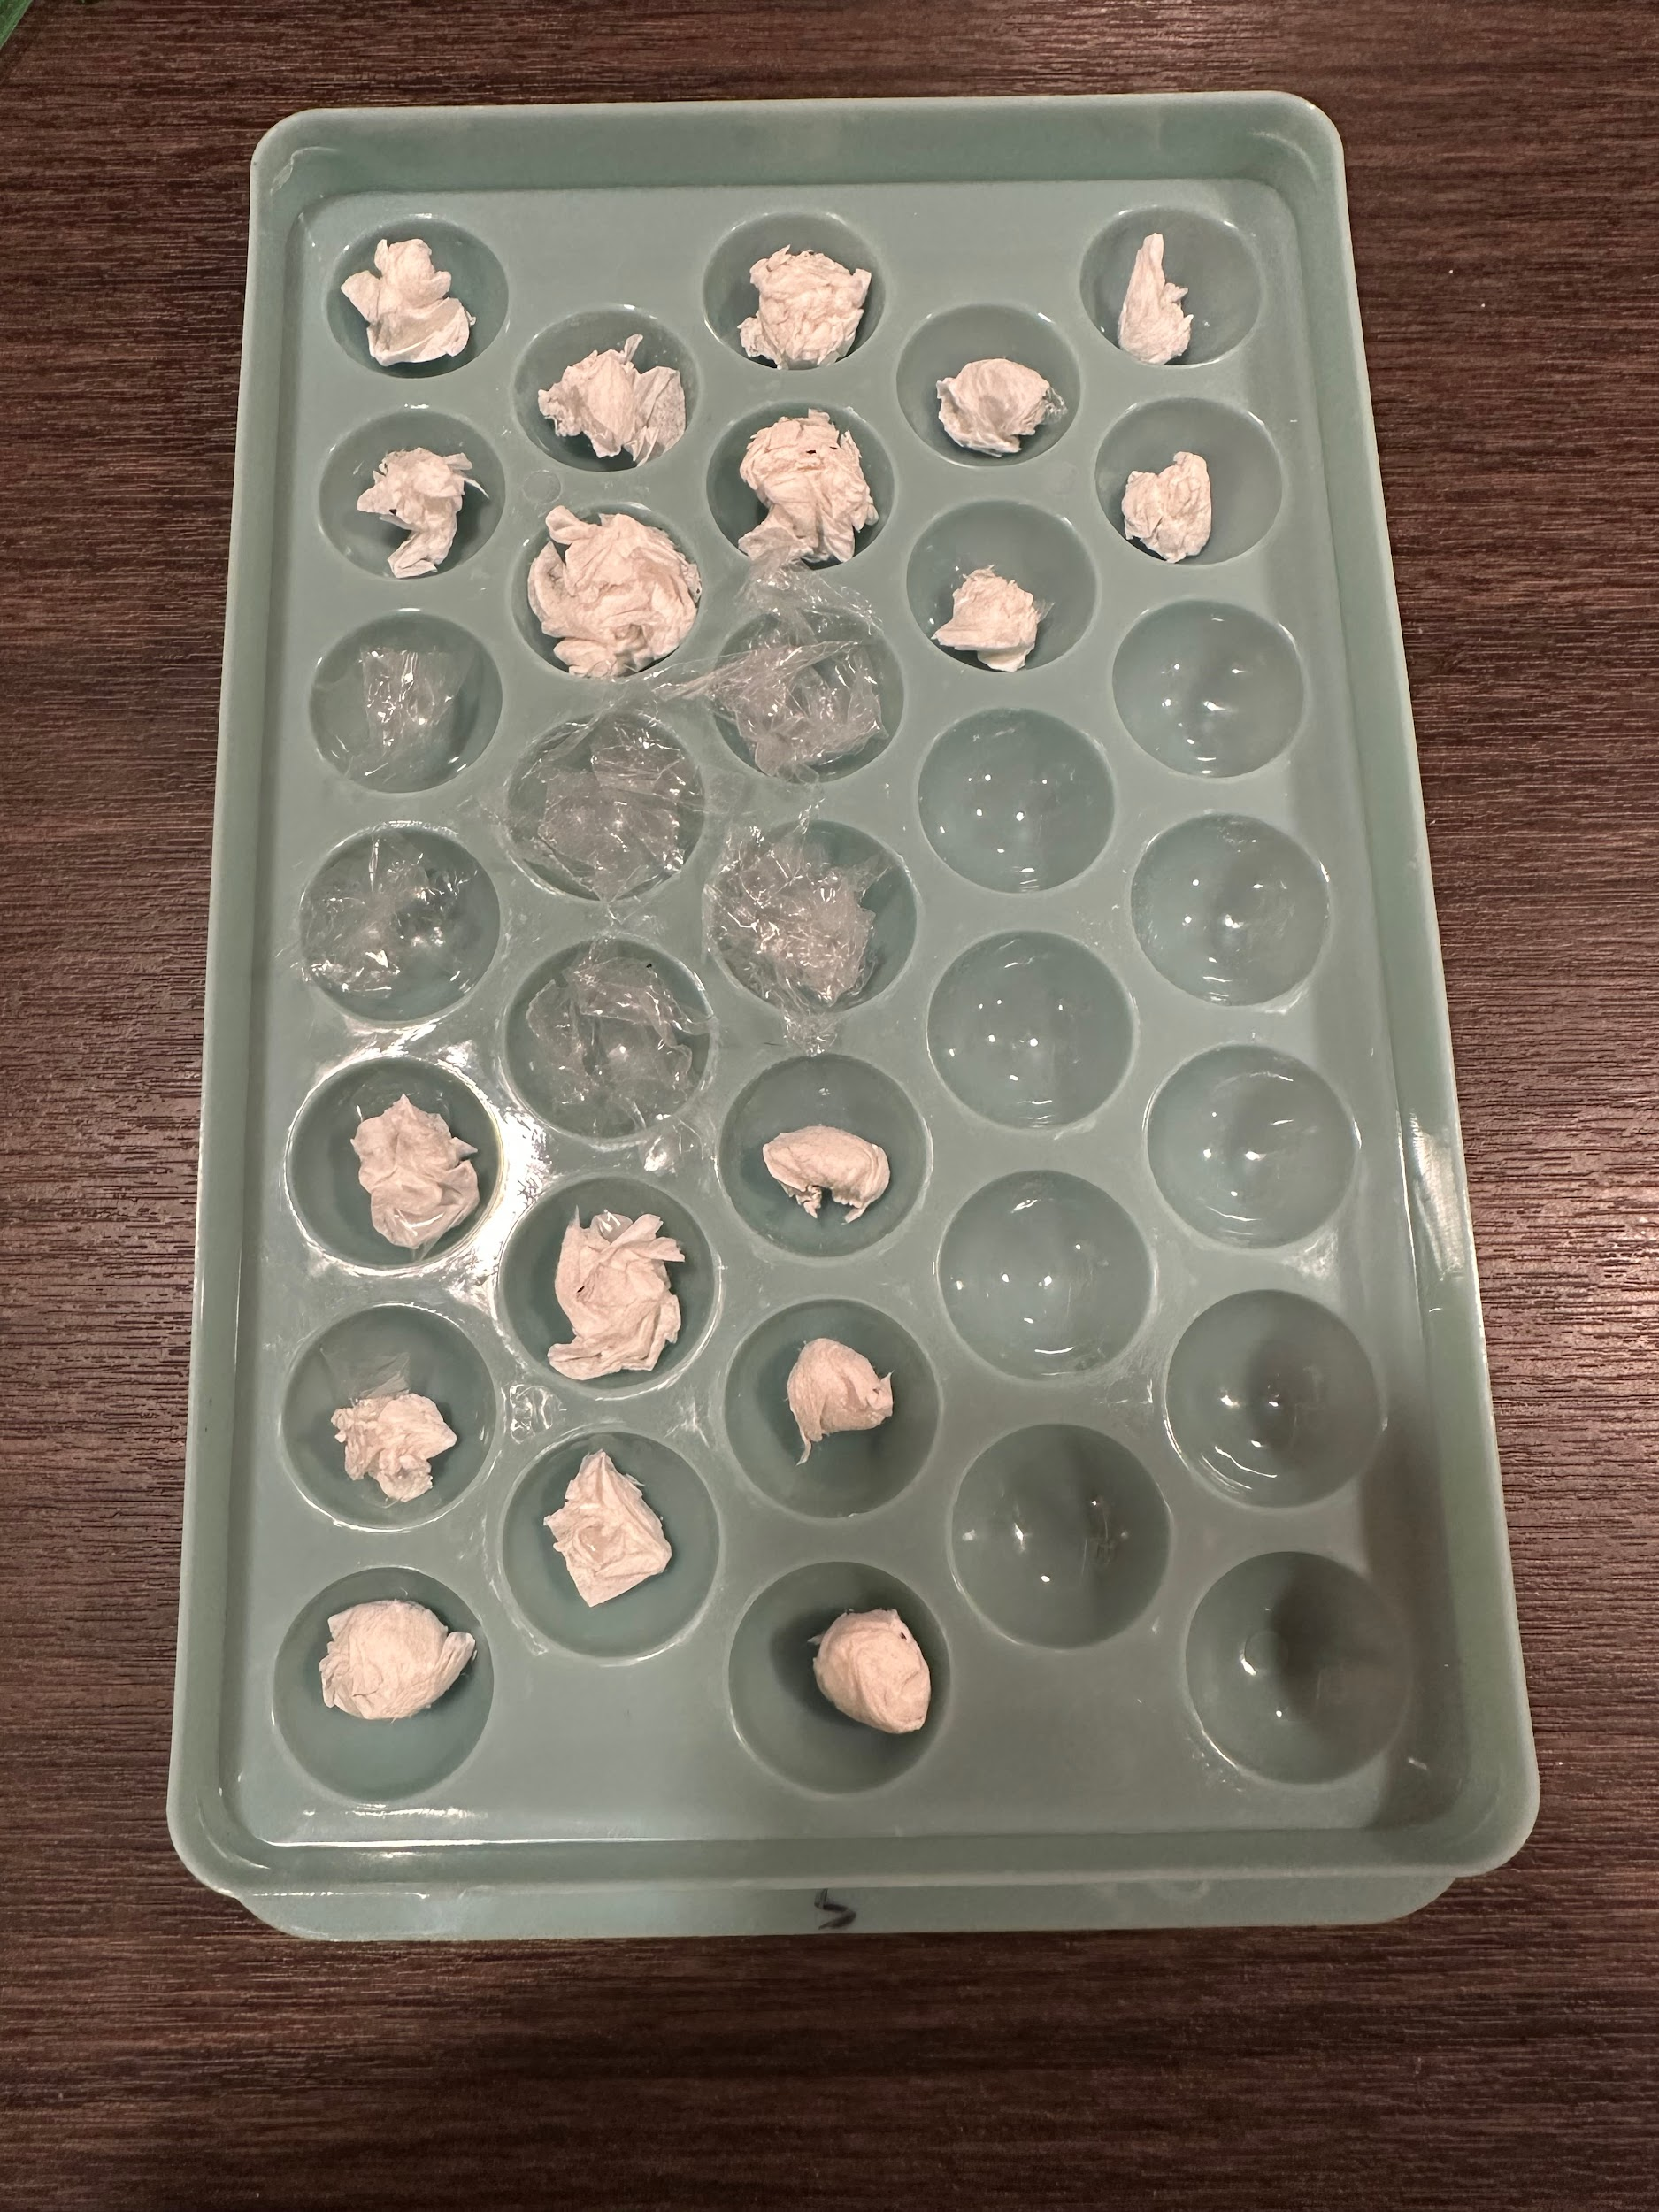
Experiment Setup
Water samples:
  9 samples (3 per height) (3 heights)
TP: 1 per height per configuration, 2 heights
  2 with 2 squares
  2 with 4 squares
  2 with 6 squares
  = 24/50 squares TP
Plastic: 1 per height per configuration, 2 heights
  2 with 2 squares
  2 with 4 squares
  2 with 6 squares
  = 24/56 squares Plastic Bag
Combined: 1 per height per config, 2 heights
  2 with 1 square of BOTH
  2 with 2 squares of BOTH
  2 with 3 squares of BOTH
  2 with 4 squares of BOTH
  = total squares (20 P, 20 TP)
Asymmetric Combination: 1 per height per configuration, 2 heights
  2 with 1 TP, 3 P
  2 with 3 TP, 1 P
  = total squares (4 P, 4 TP)
Cut plastic bag into 56 equal strips.
Cut all 5 sheets of toilet paper into 10 equal strips for 50 total.
Freezing
TOTALS:
48/50 TP Squares
48/56 Plastic Bag Squares
33/33 sphere slots used
Plastic/TP strips Prior to freezing
Notes:
Alex

Slide 6
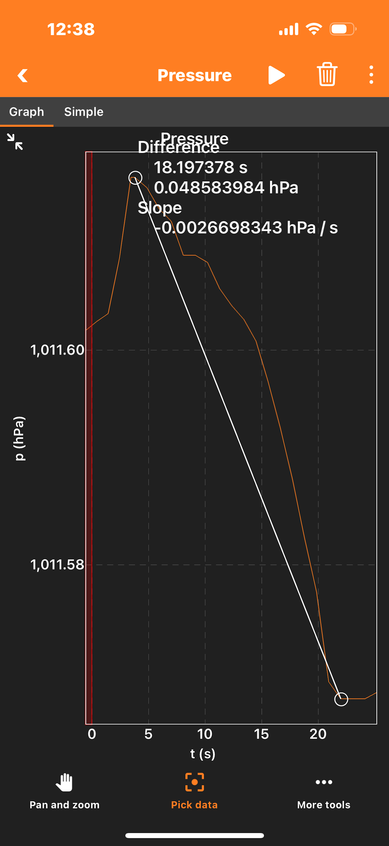
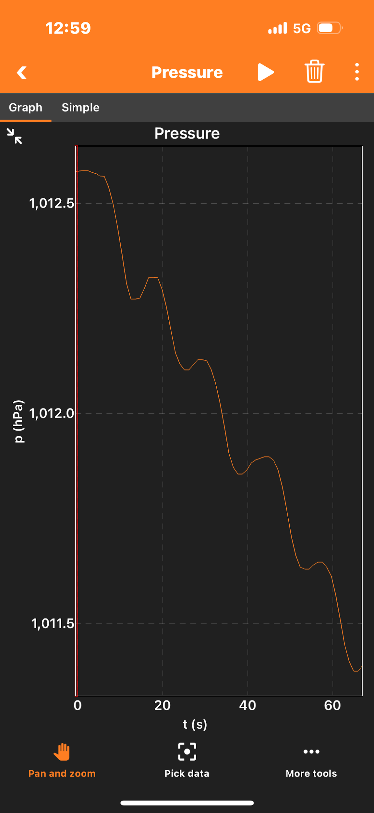
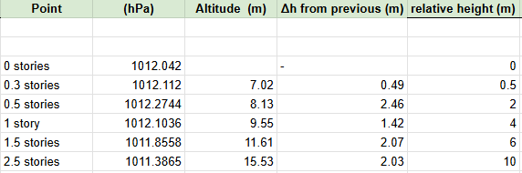
How We Measured the Drop Heights
R = 287.05 J/kgK
g = 9.80665 m/s^2
T = 293 K (68F)
Δh = (RT/g)*ln(⍴1/⍴2)
Established that the barometric data from an iPhone is accurate within 1 cm for height.
  Measured pressure on a table, then up a ruler 30 cm high.
  Found the change in height to be 31 cm, thus this is viable.
Took pressure readings at drop sight from ground level and at each staircase corner. Will use relative height for kinetic energy calculations.
DeltaH is averaged, thus 4 meters per story.
Notes:
Alex

Slide 7
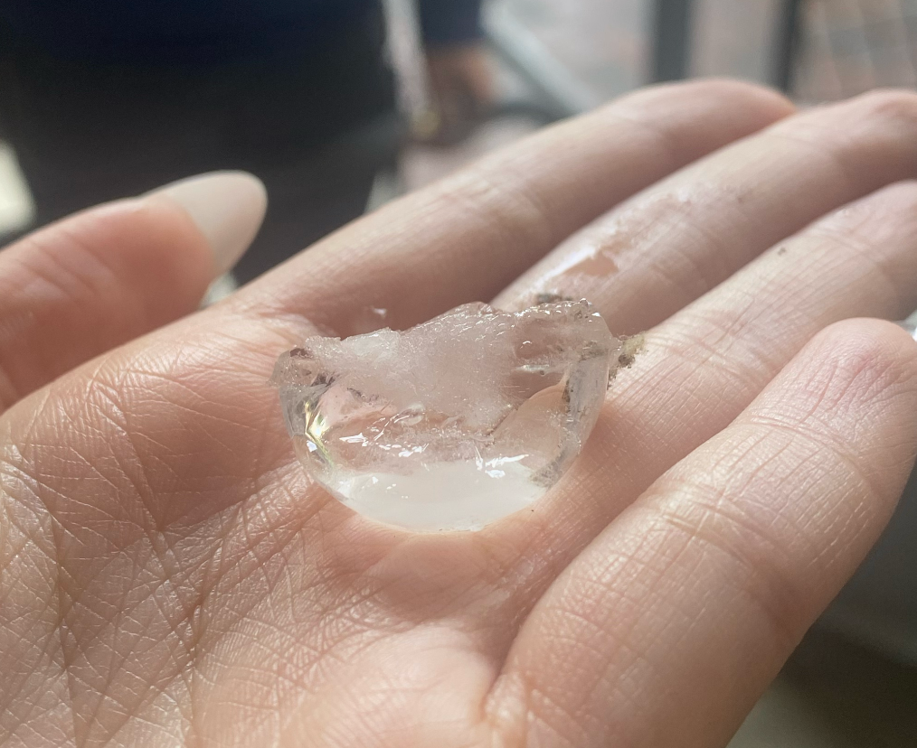
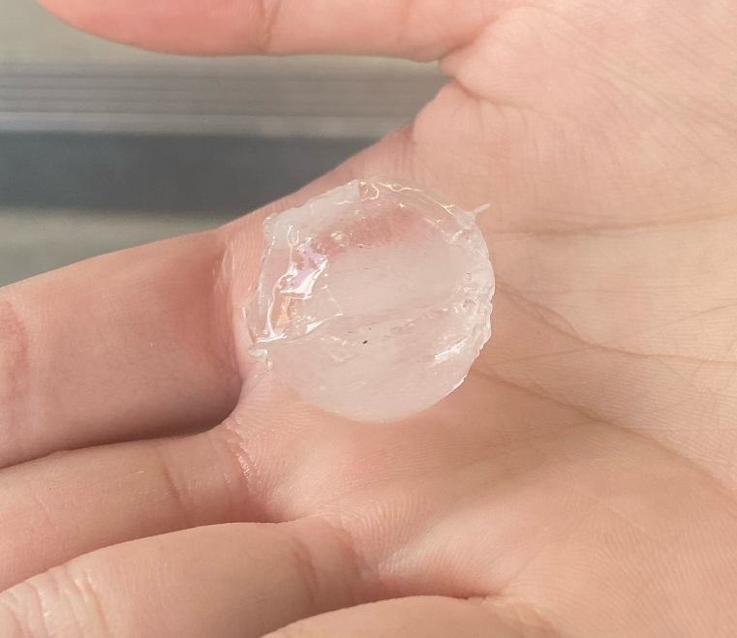
Data Table I: Control
Varying amount of damages with different heights
Composition: Ice
U = mgh = E_{Kinetic}
Height (m) | Kinetic Energy (J) | Est. Damage (%)
0.5 | 0.1047 | 10%
0.5 | 0.1047 | 30%
2 | 0.4188 | 60%
2 | 0.4188 | 20%
4 | 0.8376 | 75%
8 | 1.6752 | 5%
8 | 1.6752 | 80%
H: 2 m , 60% Damage
H: 8 m, 5% Damage

Slide 8
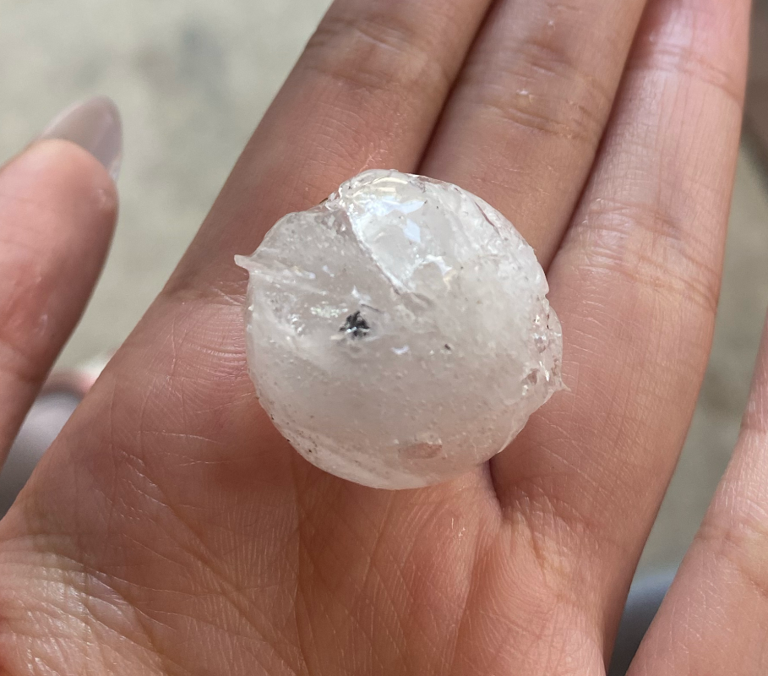
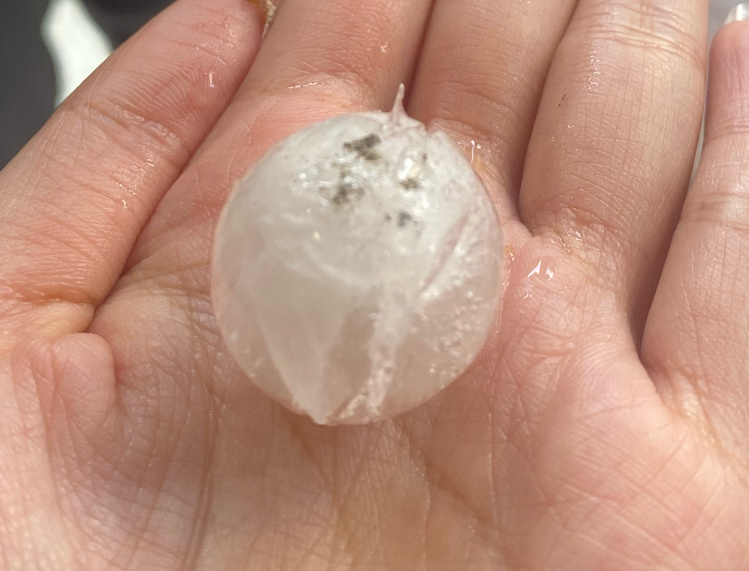
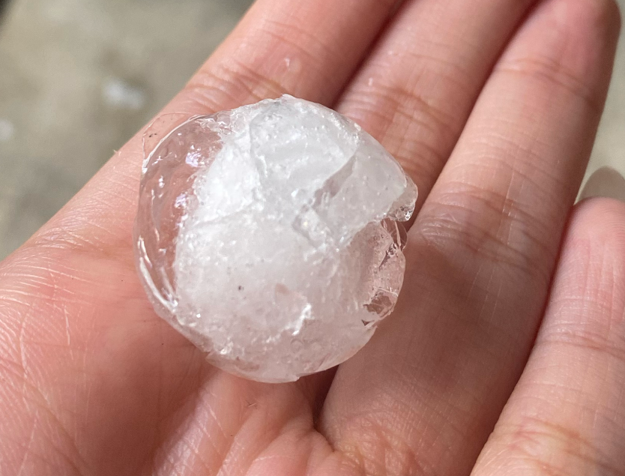
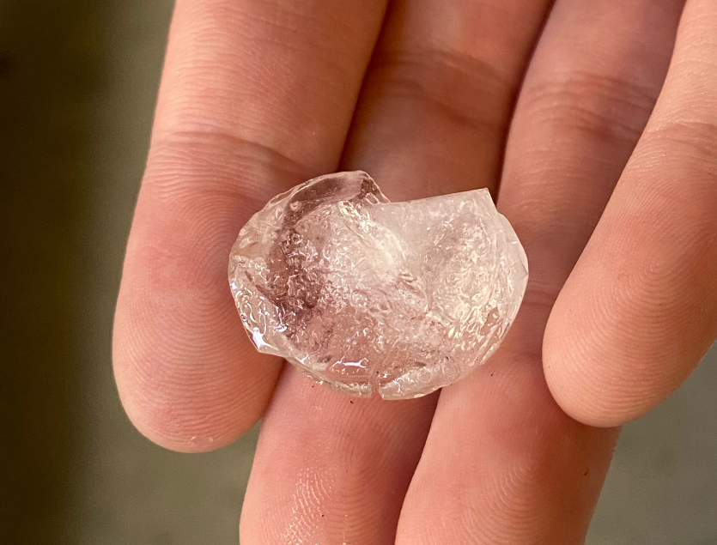
Data Table II: Toilet Paper + Plastic
6 Plastic
H: 2 m
5% Damage
6 Toilet Paper
H: 2 m
1% Damage
Composition: Toilet Paper
Composition: Plastic
Amount of TP | Height (m) | Kinetic Energy (J) | Est. Damage (%)
2 | 2 | 0.4188 | 5
2 | 4 | 0.8376 | 15
4 | 2 | 0.4188 | 3
4 | 4 | 0.8376 | 20
6 | 2 | 0.4188 | 1
6 | 4 | 0.8376 | 10
Amount of Plastic | Height (m) | Kinetic Energy (J) | Est. Damage (%)
2 | 2 | 0.4188 | 5
2 | 6 | 1.2564 | 55
4 | 2 | 0.4188 | 60
4 | 6 | 1.2564 | 70
6 | 2 | 0.4188 | 5
6 | 4 | 0.8376 | 70
4 Toilet Paper
H: 4 m
20% Damage
4 Plastic
H: 6 m
70% Damage

Slide 9
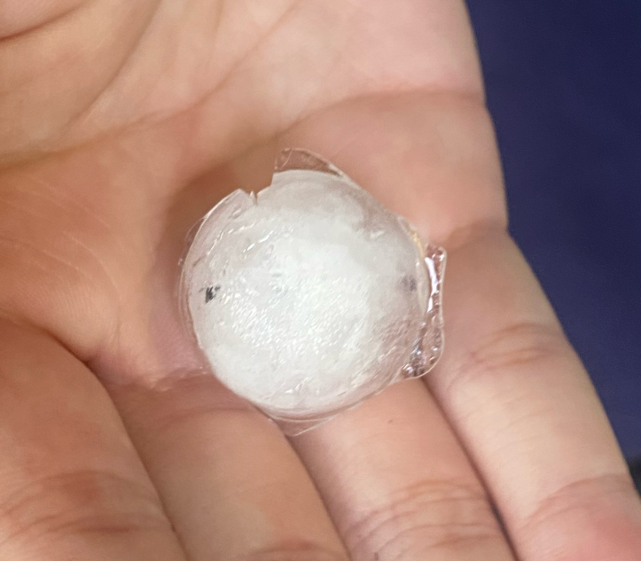
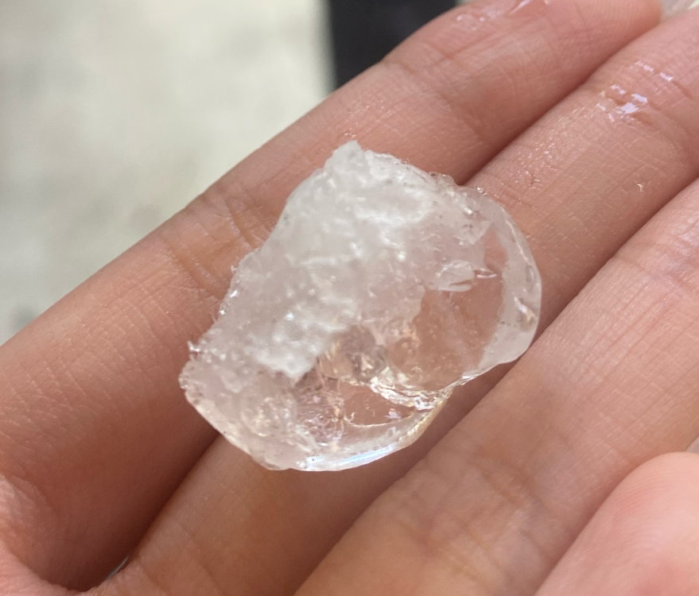
Data Table III: Mix
Composition: Mix of Toilet Paper and Plastic
Composition of Mix | Height (m) | Kinetic Energy (J) | Est. Damage (%)
1 TP + 1 P | 2 | 0.4188 | 65
1 TP + 1 P | 6 | 1.2564 | 75
2 TP + 2 P | 2 | 0.4188 | 1
2 TP + 2 P | 6 | 1.2564 | 1
3 TP + 3 P | 2 | 0.4188 | 60
3 TP + 3 P | 6 | 1.2564 | 5
4 TP + 4 P | 2 | 0.4188 | 5
4 TP + 4 P | 6 | 1.2564 | 3
Composition of Mix | Height (m) | Kinetic Energy (J) | Est. Damage (%)
3 TP + 1 P | 2 | 0.4188 | 25
3 TP + 1 P | 6 | 1.2564 | 35
1 TP + 3 P | 2 | 0.4188 | 7
1 TP + 3 P | 6 | 1.2564 | 45
2 Toilet Paper + 2 Plastic
H: 6 m
1% Damage
1 Toilet Paper + 1 Plastic
H: 6 m
75% Damage

Slide 10
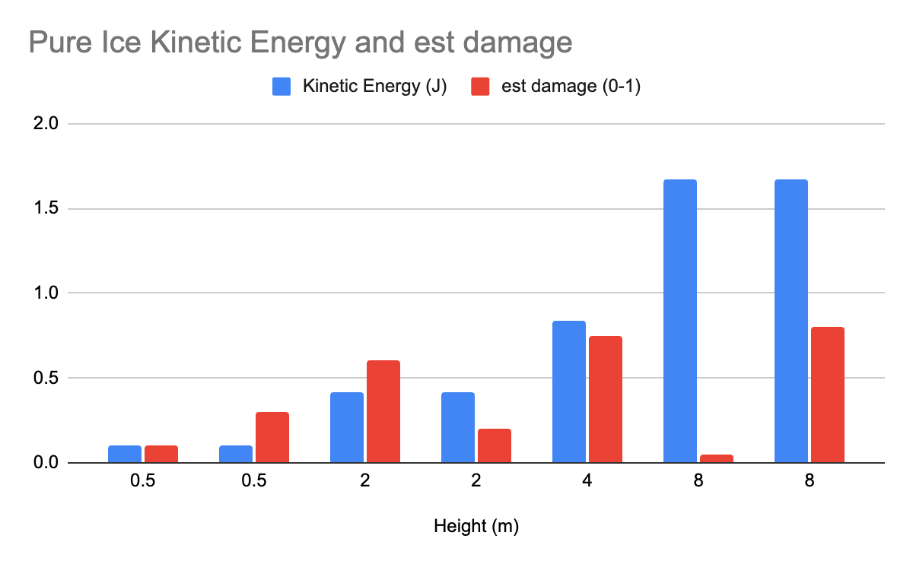
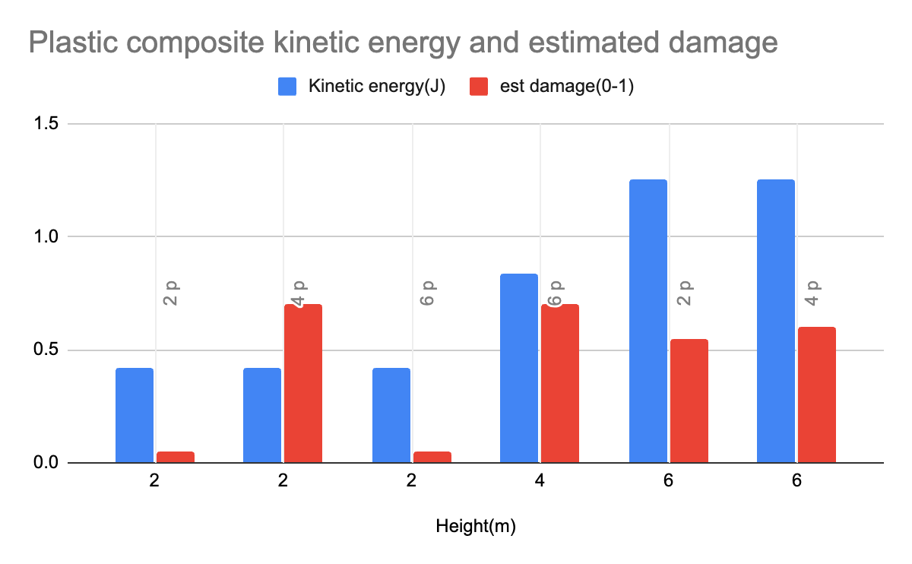
Graphs

Slide 11
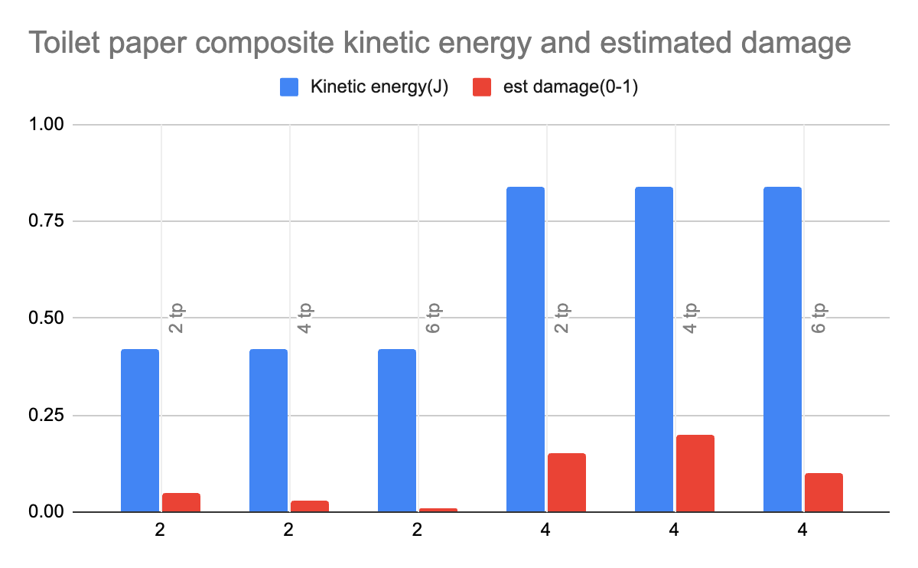
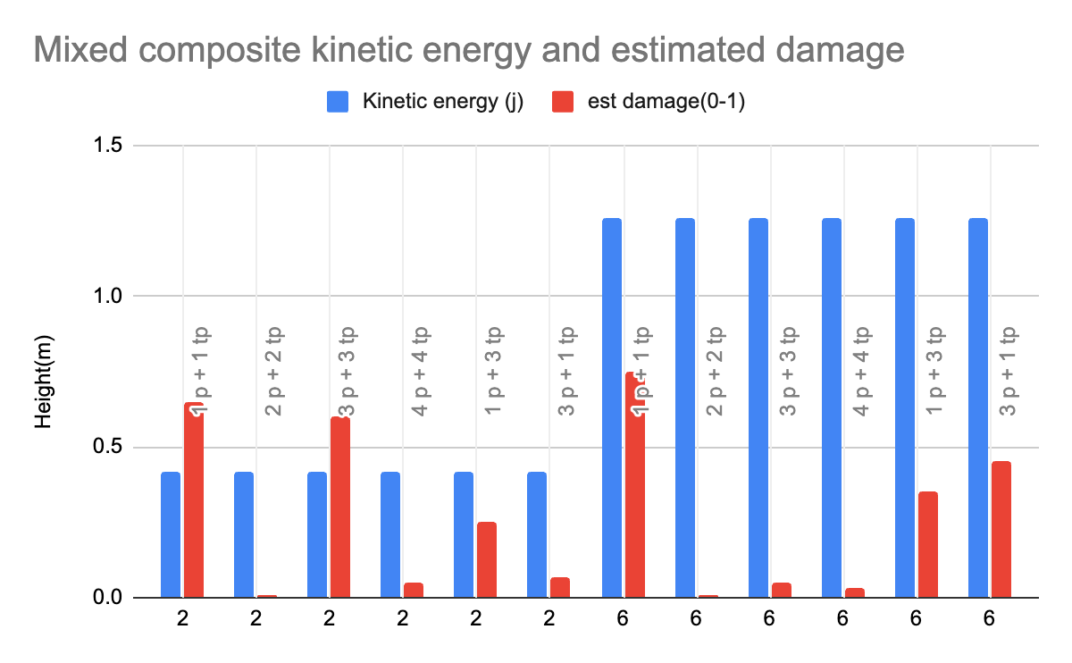
Graphs

Slide 12
Sample calculation
Estimate the thickness of ice and/or ice composites needed to stop an iron micrometeoroid with density 8 g/cm^3 that is 3 cm in diameter traveling at 42 km/s.
K = ½ mv² → dK = ½ dm × v² → dm = ⍴ × dV → ∫dK = ½ ⍴ v² ∫dV → K = ½ ⍴ v² ×V
K = ½ (8000)(42000)² × 4/3π(0.015)³ = 9.98 × 10⁷ J for meteoroid
where V = 4/3πr³
Assuming that our ideal sphere absorbs and dissipates 100% of the kinetic energy
U = mgh, m = ⍴V → U = ⍴Vgh
where V = 4/3πr³
⍴ = 917 kg/m³, h = 6 m, g = 9.81 m/s², r = 0.0177 m
U = (917)(4/3π(0.0177)³)(9.81)(6) = 1.25 J/Sphere or 5.39 × 10⁴J/V
9.98 × 10⁷ J
= 7.984 ×10⁷ spheres × 0.0354 m = 2.826336 × 10⁶ meters
1.25 J / sphere
or 1.85 km thick of ice assuming an area of 1 m²
diameter of single ice sphere

Slide 13
Results
Plastic may be less consistent or less effective at dissipating impact energy compared to toilet paper
Plastic reinforced spheres damage ranges
  At 2 m: 5–70%
  At 4–6 m: up to 70%
Toilet paper reinforced spheres damage ranges
  At 2 m: 1–5
  At 4 m: up to 20%
Balanced reinforcement with both materials can be effective, especially when toilet paper is present in equal or greater amounts than plastic
3 TP + 3 P at 6 meters resulted in only 5% damage an 2TP +2 P at 6 meters resulted in 1% damage , while 1 TP + 3 P had 45% at the same height.
The amount of ice needed to stop a meteoroid travelling at this speed is very impractical, even with reinforcement taken into consideration.

Slide 14
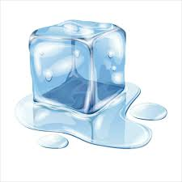
Sources of Error
Human Error
  The estimated amount of damage recorded is subjective from person to person and can be inaccurate.
Construction of the ice spheres
  Materials in ice could have been concentrated in one place of the sphere
  Potentially inconsistent freezing patterns varying from sphere to sphere.
Ice may have been melted before it was dropped.
  Temperature outside could have fluctuated during the duration of the experiment
  Samples were held with bare hands, slightly melting due to body heat
Notes:
Nathan if he shows up

Slide 15
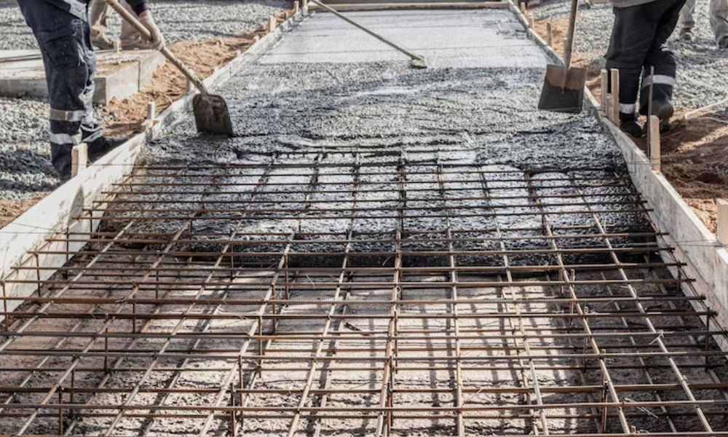
Practical Application
Past Applications
Project Habbakuk
  A project in WW2 by the British to construct an aircraft carrier out of a composite material pykrete, composed of ice and wood pulp, that would make slower melting rates and comparable strengths to concrete
  Ultimately abandoned due to scale, no insulation for humans, and the environment it would be used in
Present/Modern Applications
Rebar in concrete to make buildings
  The brittle concrete reinforced with steel provides higher tensile strength and prevents cracking or collapsing
Fiberglass in Plastic Resin
  Used in boats, surfboards, aircraft components, car bodies, etc.
  Provides for high strength, lightweight, durable material that can withstand large amounts of stress
Carbon fiber reinforced polymers
  High performance composites in aerospace and sports gear
  Used in planes, rockets, and high performance cars (ex. F1 vehicles)
  High strength to weight ratio and resistance to impact, deformation, fatigue
Barczak, N. (2024, September 24). Project Habbakuk: A ship from ice!. DMS Marine Consultant. https://www.dmsonline.us/project-habbakuk-a-ship-from-ice/

Slide 16
Thank you!

