Slide 1
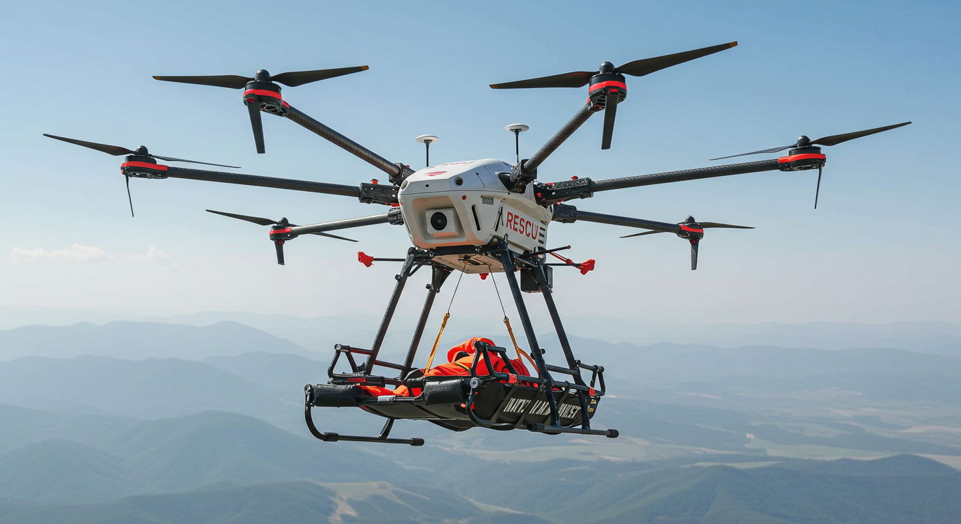
ExtrakPak
Drone With Advanced Grappling Technology to Extract Deceased Soldiers Behind Enemy Lines
Group 4
Team Leader:
Alex Amadeo-Ranch
Members:
Ryan Muraliraj, Jack Proctor
Source: ImageFx - Google (2/9/25) [1]

Slide 2
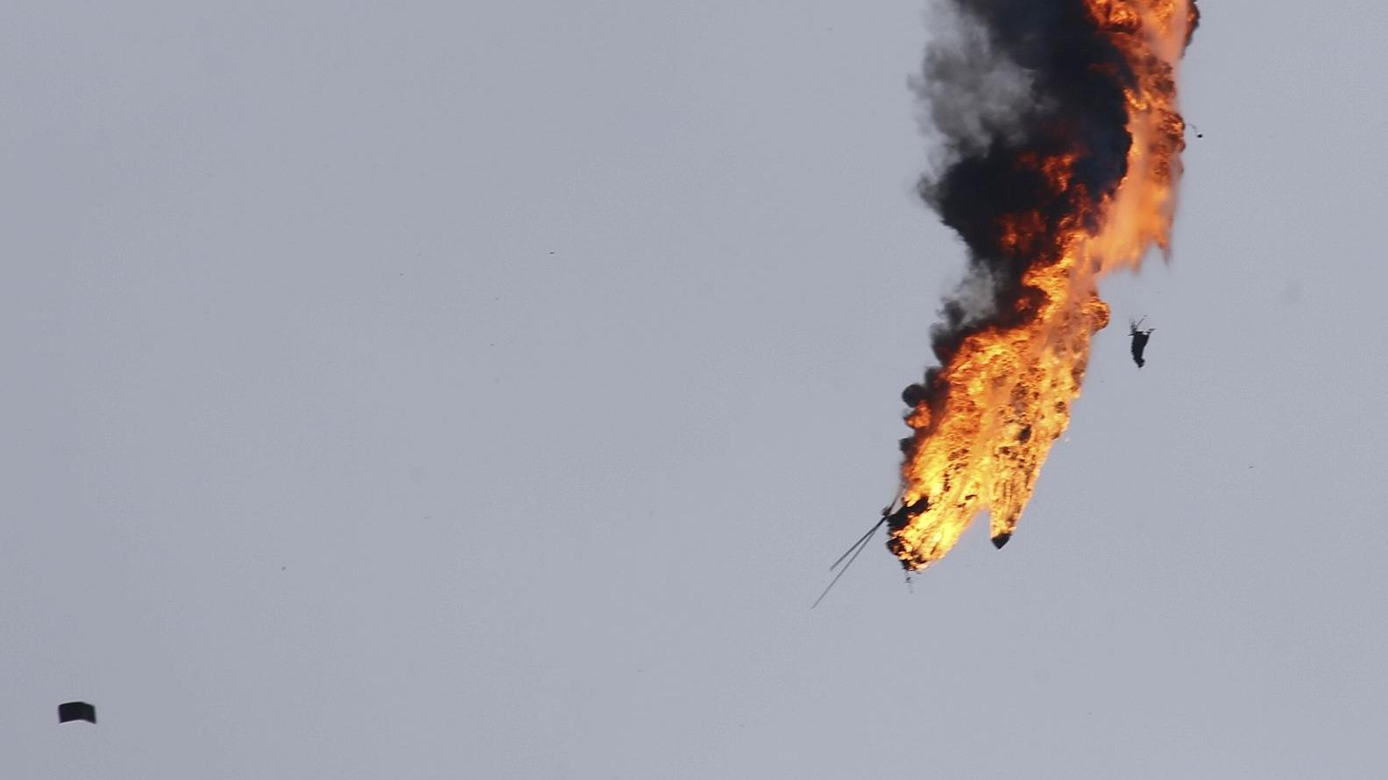
Problem
United States Department of Defense (DoD) has a policy to recover deceased soldiers [1].
DoD reports 38,000 U.S. soldiers are recoverable [2].
Mission risks prevent recovery efforts.
Risks [3]:
Enemy attacks.
Untraversable terrain.
Source: Military Watch Magazine (2020) [2]

Slide 3
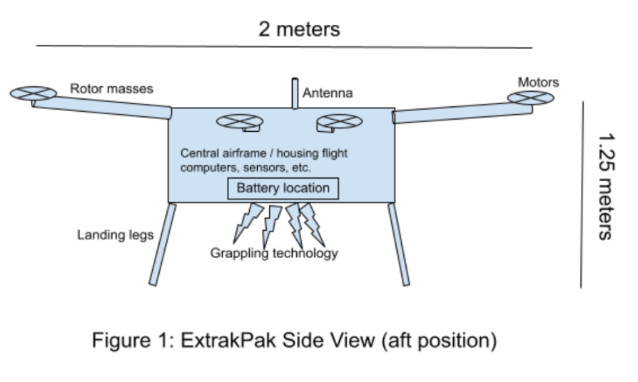
Proposal
Remote-controlled.
Rescue procedure:
Navigate to deceased soldier.
Secure soldier with grappling technology.
Fly to the recovery site.
Release individual.

Slide 4
Work Product (The Drone)
200 kg payload
1 hour flight time
Max 60 kph wind
Max 0.35 cm/h rain
TWR 1.16
Radar/LiDAR.
Swappable lithium-ion batteries.

Slide 5
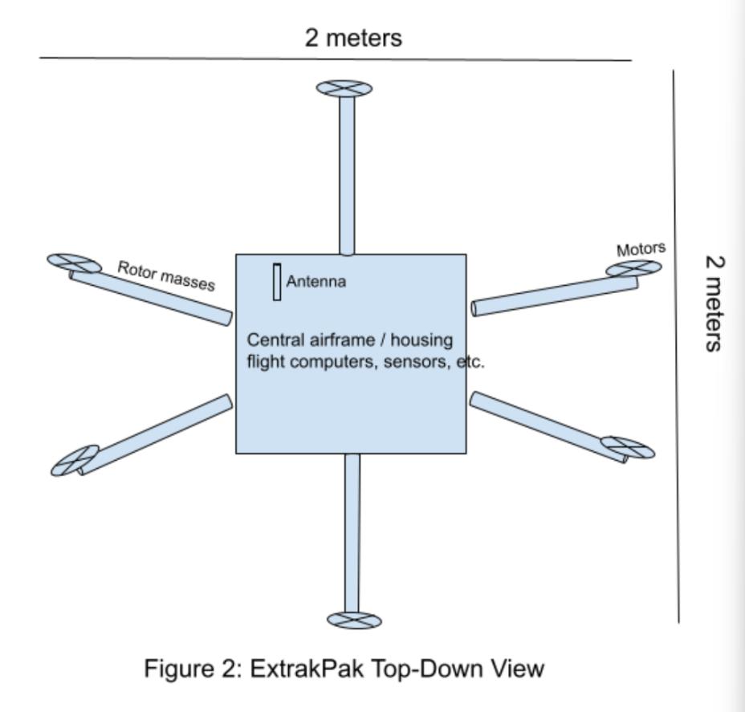
Work Product (The Drone part 2)
Carbon fiber airframe.
6 brushless motors.
3 flight computers.
Encrypted communication.

Slide 6
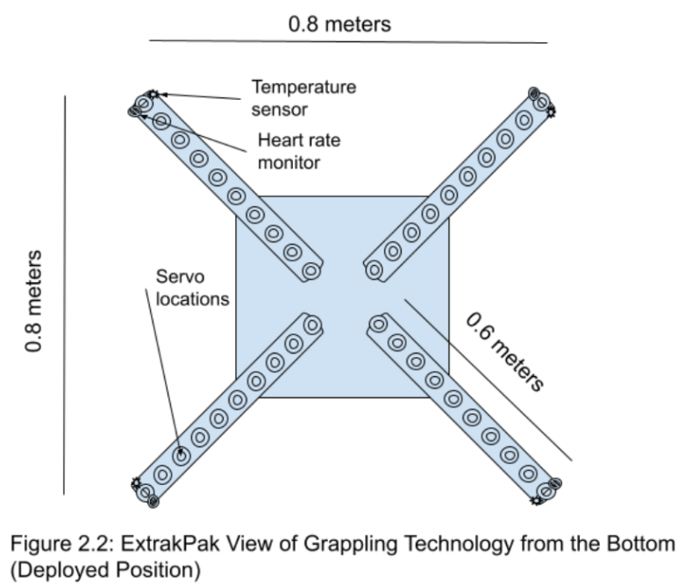
Work Product (Grappling System)
Grapples deceased soldier.
Based on octopus arms.
4 arms, 10 pivot points.
0.6m fully extended.
Aluminum center, silicon exterior.
Each arm supports 400kg.
Biometric monitoring.

Slide 7
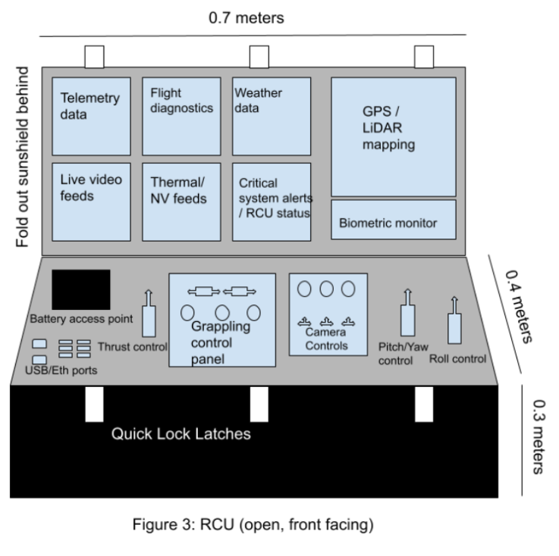
Work Product (RCU)
Remote Command Unit (RCU).
Sturdy, waterproof case.
Display screens for important information
Control interfaces.
Swappable lithium-ion batteries.

Slide 8
Work Product (Regulations)
Federal Aviation Administration (FAA) Part 107
operation from a moving aircraft §107.25
operation at night §107.29(a)(2) and (b)
visual line of sight aircraft operation §107.31
operation over human beings §107.39
operations over moving vehicles §107.145
Federal Drug Administration (FDA) Class II
Occupational Safety and Health Administration
Personal Protective Equipment (PPE) §1910.132
Hazard Assessment and Equipment Selection §1910.132(d)

Slide 9

Target Customer
U.S. Department of Defense (DoD)
DoD oversees all branches of the military.
The Defense POW/MIA Accounting Agency conducts yearly recovery investigations.
End-User:
Extraction teams across all branches of the military.
Source: U.S. Department of Defense [3]

Slide 10
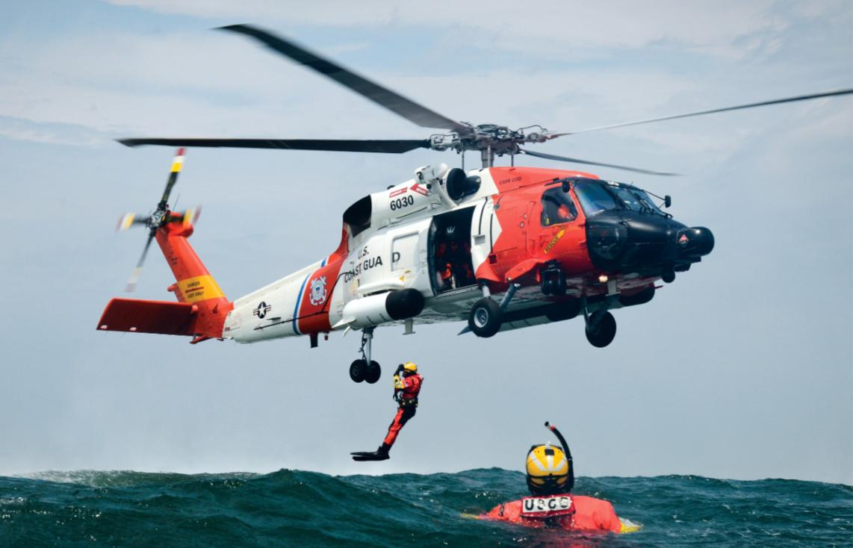
Competition: Existing Methods
Current methods include helicopter extraction, which is costly, requires a crew of 6-12 people to operate, big target.
Sikorsky UH-60 Blackhawk:
$25 million per unit average $2,200 to fly per hour
ExtrakPak’s estimated selling price:
$250,000
Source: lockheedmartin.com [4]

Slide 11
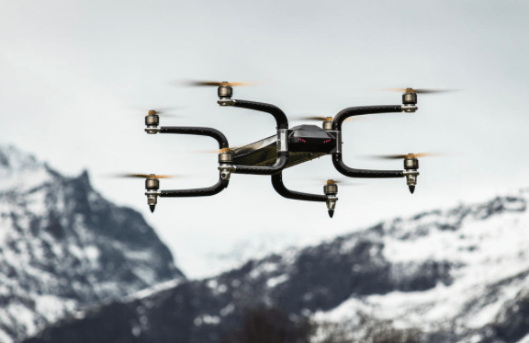
Griff Aviation 300
Pros:
225 kg (496 lbs) payload
Max speed: 60 mph
Cost average: $250,000
Heavy Inspiration for ExtrakPak
Cons:
No grappling tech
Flight time of 30-45 mins
Source: unmannedsystemstechnology.com Dec. 2016 [5]

Slide 12
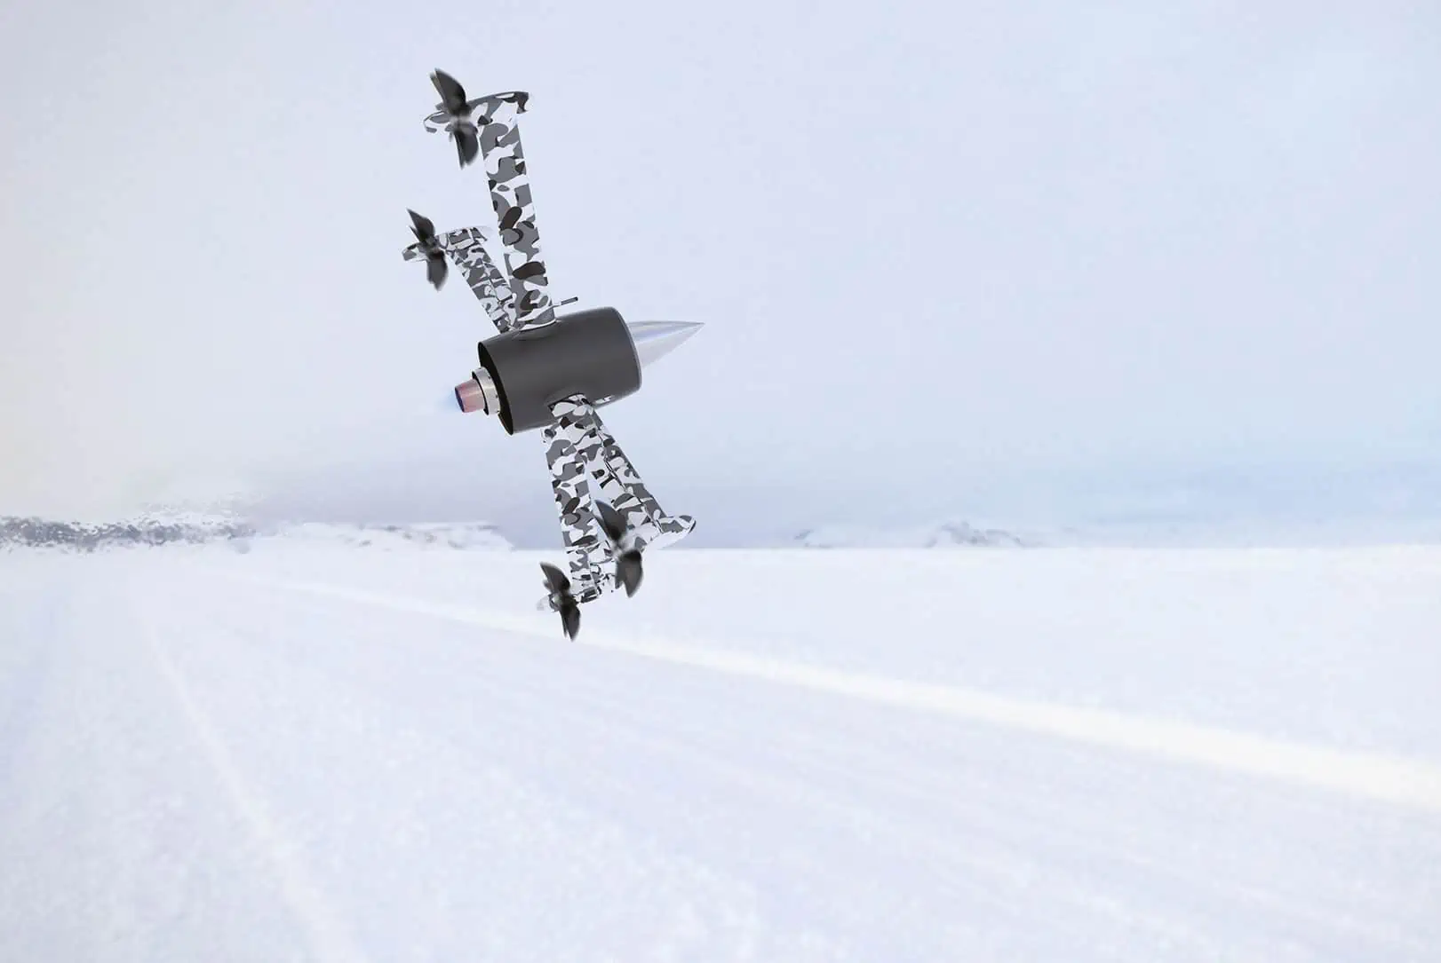
Huntress II VTOL Turbojet
Pros:
Capable of withstanding 55 - 63 mph winds
Flight time: 120 mins
Max speed: 300 mph
Estimated cost: $200,000
Cons:
No grappling tech
50 kg (110 lbs) max payload
Framework does not support capabilities to transport humans (thruster on bottom, payload is distributed throughout arms)
Source: unmannedsystemstechnology.com Dec. 2016 [6]

Slide 13
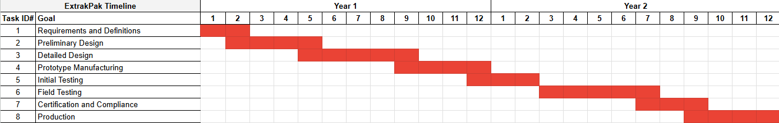
Methodology
How will we develop ExtrakPak?
2 Years of Development

Slide 14
Methodology
Estimated Costs of ExtrakPak
Research and Development | $3,450,000
Subtotal for Production of Single Unit | $215,000
Total Estimated Unit Selling Price | $245,000-$265,000

Slide 15
User Risk Management
Fly within ExtrakPak’s performance envelope.
Winds/gusts 60 kph+ or rainfall 0.35 cm/h+
Flight warnings use real-time weather satellite data.
Update the drone and RCU’s software regularly.
May jeopardize network security and communications.
Flight warnings by automated checks for updates.
Only intended for extracting deceased personnel.
No lifesaving capabilities.
Temperature and heart rate sensors check for signs of life.

Slide 16
Conclusion
DoD is committed to returning fallen heroes to their families.
DoD needs safer solutions for extracting the deceased behind enemy lines.
38,000 are not recovered.
ExtrakPak revolutionizes the DoD’s deceased recovery logistics.
No personnel risk.
Closure to the families of those who made the ultimate sacrifice.

Slide 17
References
[1] https://cascom.army.mil/g_staff/g3/TTD/Products/QM-How-to-Handbook-MortuaryAffairs.pdf
[2] https://www.defense.gov/Multimedia/Experience/POW-MIA/
[3] https://docs.google.com/document/d/1ZirRbLOfYkGK-BNwAkX_ILJF4KWJB5TB_YcX5NXzLk8/edit?tab=t.0

Slide 18
Image References
[1]
https://labs.google/fx/tools/image-fx
[2]
https://militarywatchmagazine.com/article/turkish-f-16-downed-syrian-mi-17-helicopter-over-idlib-reports
[3]
https://www.defense.gov/Brand-Guide/
[4]
https://www.lockheedmartin.com/en-us/products/sikorsky-black-hawk-helicopter.html
[5]
https://www.unmannedsystemstechnology.com/2016/12/griff-aviation-announces-new-griff-300-heavy-lifting-drone/
[6]
https://www.unmannedsystemstechnology.com/company/waveaerospace/huntress-ii-vtol-turbojet/

